Slide 1
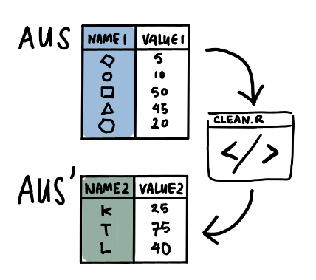
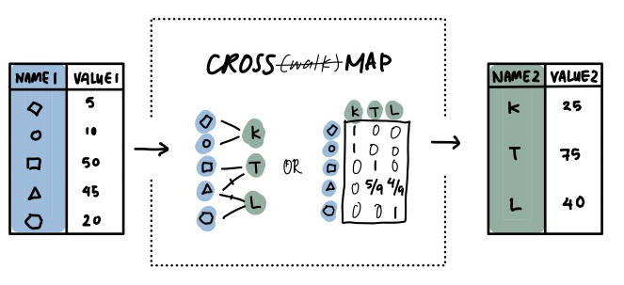
Crossmaps: A principled approach to ex-post data harmonisation and dataset integration
Cynthia A. Huang

